Slide 1



Slide 2
WORKSHOP
(https://github.com/pact-foundation/pact-workshop-js)
REMINDER
Pre-requisites
Node.js 16, 18 or 20
Clone project
Run npm i
Have a PactFlow account and a read-write API token
Comfortable operating a command line / terminal
OSX or Linux environment ideal

Slide 3



ABOUT ME
Developer Advocate @ SmartBear
Tester/Developer/Consultant since 2007
Once left IT as a career to restore old automobiles, but returned as I enjoyed conversing, learning and teaching
you54f

Slide 4
AGENDA + HOUSEKEEPING
Agenda
& housekeeping
The 2 - 2.5 hour workshop covers:
Introduction to Pact (presentation)
Hands-on lab (step 1-5)
5-10 minute break
Hands-on lab cont. (step 6-12)
Q&A
🔴 Session is being recorded
Notes:
Business impact of integrated tests
Cause / explanation of these effects -> these are some of the arguments you can use to combat on your client site
Alternative approach (isolation + contracts)
Pact

Slide 5




BACKGROUND
The numbers
Four key indicators of high performing organisations¹
Need < 1 day lead time for changes = 106x faster time from commit -> deploy
Are able to deploy on demand = 208x more deployments
Have change failures rates < 15% = 7x lower change failure rates
Can restore services within 1 hour = 2604x faster MTTR
¹ Data from the DORA 2019 State of DevOps report
Notes:
We know what good looks like. The state of devops
In addition, Automated deployments (to test or prod, including automated environment provisioning) are associated with ~70% of elite performers

Slide 6
BACKGROUND
The numbers
Challenges facing the market
Only 20% of companies are “elite” performers¹
81% of teams spend a third of their time or more on fixing environments²
36% of teams are impacted by wait times and cost of test environments²
76% spent one third of their time or more managing test data²
¹ Data from the DORA 2019 State of DevOps report
² Data from a Capgemini report on continuous testing in March 2019

Slide 7
ABOUT PACTFLOW
In 2013 we created Pact, an Open Source tool to solve this problem. In 2019, we launched PactFlow to enable organisations to do this at scale. In 2022, we were acquired by SmartBear allowing us to fit our contract-testing story, alongside a suite of tools designed to address the challenges of API and Product development, affecting the teams of today, and generations beyond.

Slide 8











HOW WE TEST MICROSERVICES NOW
The old way...
Why this is hard
Slow
Fragile
Hard to debug
Test data management + environment management
Coverage?
All-at-once painful deployments
Teams wait on build queues
JSON/HTTP
JSON/HTTP
API Gateway
JSON/HTTP
JSON/HTTP
Microservice A
Microservice B
JSON/HTTP
#1
#2
#3
#4
#5
JSON/HTTP
JSON/XML
Microservice C
MQ

Slide 9
HOW WE TEST MICROSERVICES NOW
Scaling
Developer idle time (queues)
Build time
Risk associated with change
Cost / Complexity / Time
# Environments
Teams + Components
Linear increase in teams and components results in exponential increase in other factors
Number teams / components
Notes:
We find that we have Cohesive services, loosely coupled (want) but have cohesive teams, tightly coupled by services (got)

Slide 10
HOW WE TEST MICROSERVICES NOW
Where we went wrong
Cause and effect
Test and/or Release coupling
Environment management vs developer idle time
Slower pipeline leading to batching
Batching increases failure and defect rates
Increased deployment risk
Separate testing teams introduced
“Release Manager” introduced to govern the entire release process
Tech debt accumulation
Approach for monoliths does not work for distributed systems
Notes:
Our teams were able to build independently, but were forced to collaborate closely in order to ship;
We had to manage and pay for an exponential amount of environments, or wear the cost of additional developer idle time;
Our delivery pipeline has grown linearly in time resulting in batching changes together;
Batching has resulted in increased failure and defect rates;
Integration tests failure results in disproportionately more time debugging them;
Deployments are riskier than when we were continuously shipping the original monolith;
The role of “Tester” emerged, whose job was to manually test features in fixed environments and fix build issues instead of coaching and doing exploratory testing;
The role of “Release Manager” emerged, to govern the entire release process;
Tech debt has accumulated as a result of these pressures.
We used the same tools and approaches that worked for monoliths and applied it to our new world

Slide 11
HOW WE TEST MICROSERVICES NOW
“Integration tests are a scam”
JB Rainsberger
Notes:
Any test where its success/failure depends on many different bits of interesting behaviour at once

Slide 12
HOW WE TEST MICROSERVICES NOW
Scam, you say? Justify!
Integrated tests are:
Slow
Fragile
Hard to manage
When they fail, you can’t point to the problem!

Slide 13
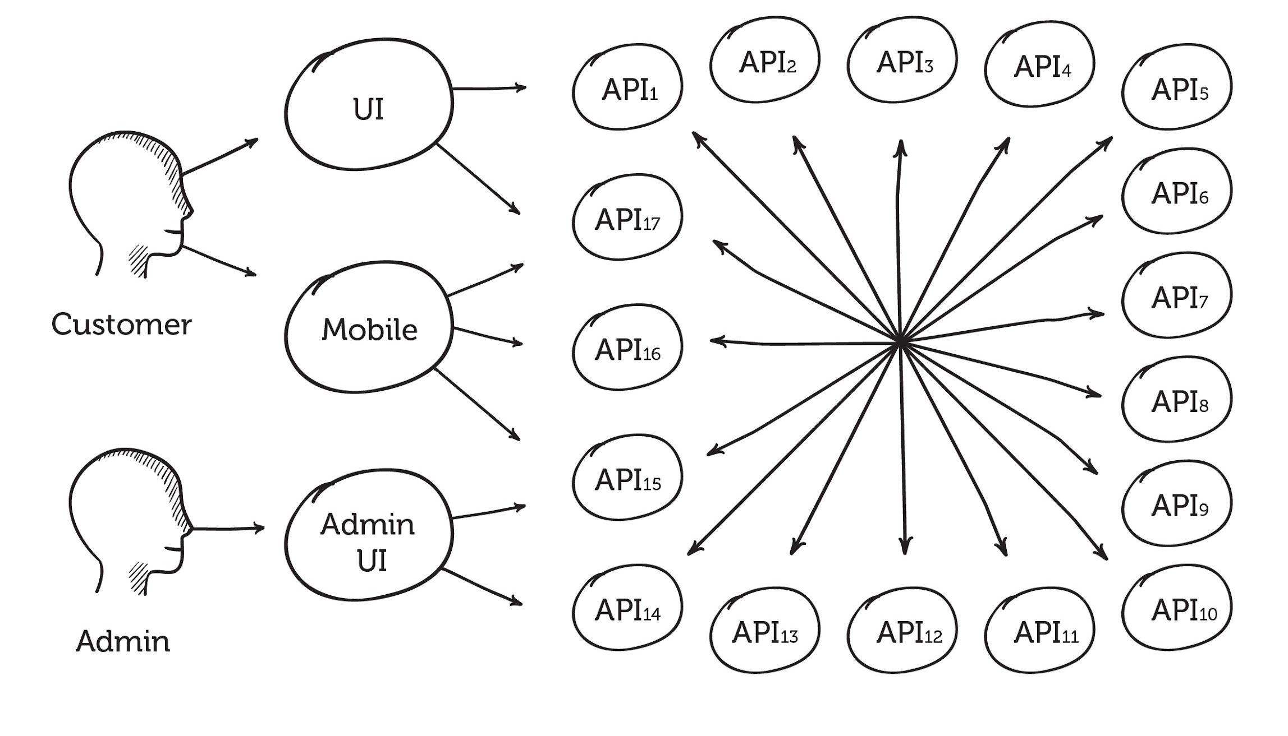
HOW WE TEST MICROSERVICES NOW
Notes:
How can we get 100% coverage here?
Consumer -> Provider 3 integration tests actually cover 7 boxes.
Let’s assume Downstream 1+2 are terminating cases.
Code path complexity is combinatorial:
Assuming only 2 branches in each box ~ 128
Assuming only 5 branches in each box ~78,125
Assuming 10 branches in each box ~10M
If we add another component with 10 branches we get 100M!
For every layer, we increment the exponent

Slide 14
HOW WE TEST MICROSERVICES NOW
Branches per box vs test cases required
2 code branches = 128 tests
5 code branches = 78,125 tests
10 code branches = 10M tests

Slide 15
HOW WE TEST MICROSERVICES NOW
Notes:
Actual architecture for a institution in the financial Melbourne

Slide 16
A BETTER WAY TO TEST MICROSERVICES
Good tests have the exact opposite properties
Notes:
Speed
Isolation
Simplicity
But how can we do this across service boundaries???

Slide 17
A BETTER WAY TO TEST MICROSERVICES
Mocks to the rescue?
Notes:
Speed
Isolation
Simplicity
But how can we do this across service boundaries???

Slide 18
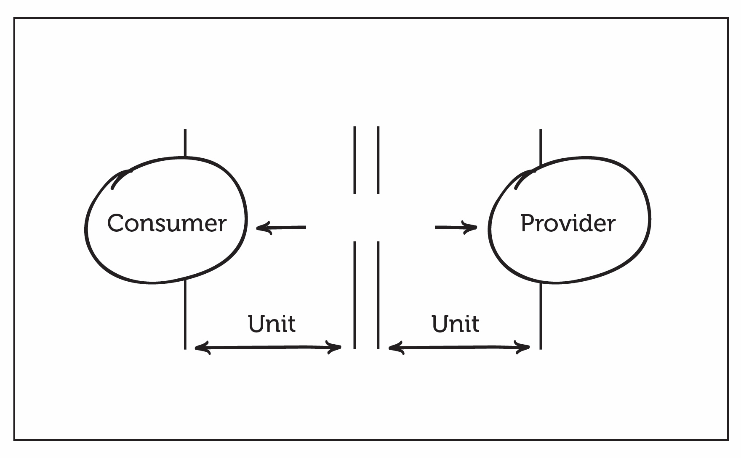
A BETTER WAY TO TEST MICROSERVICES

Slide 19

A BETTER WAY TO TEST MICROSERVICES

Slide 20
A BETTER WAY TO TEST MICROSERVICES
Mocks
Solved problems
New problems
Fast feedback
Few dependencies
No dedicated environment
Reliable
Easy to debug
Hard to keep both sides in sync
20

Slide 21
A BETTER WAY TO TEST MICROSERVICES
How about API Specs?
Notes:
OK, so we’ve established that integrated tests are bad and we want isolation.
Perhaps documenting APIs and properly versioning them will be better??

Slide 22
A BETTER WAY TO TEST MICROSERVICES
How to: Spec first development
Architect independent of teams postulate API requirements
Document perfect API (Swagger/OAS etc.)
Create said API
Publish said document to consumers
Repeat steps 1-4
Notes:
Speed
Isolation
Simplicity
But how can we do this across service boundaries???

Slide 23
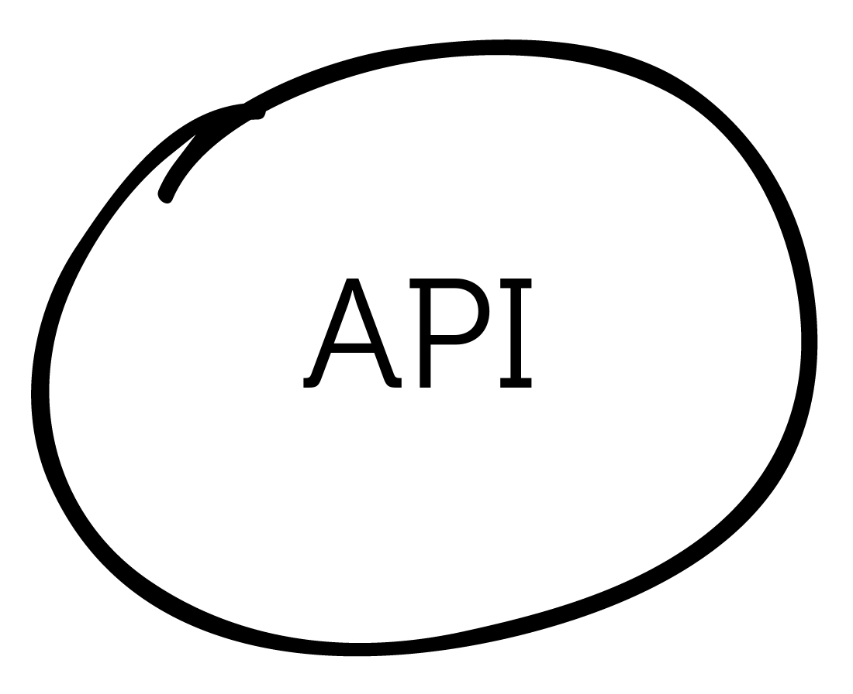
A BETTER WAY TO TEST MICROSERVICES

Slide 24
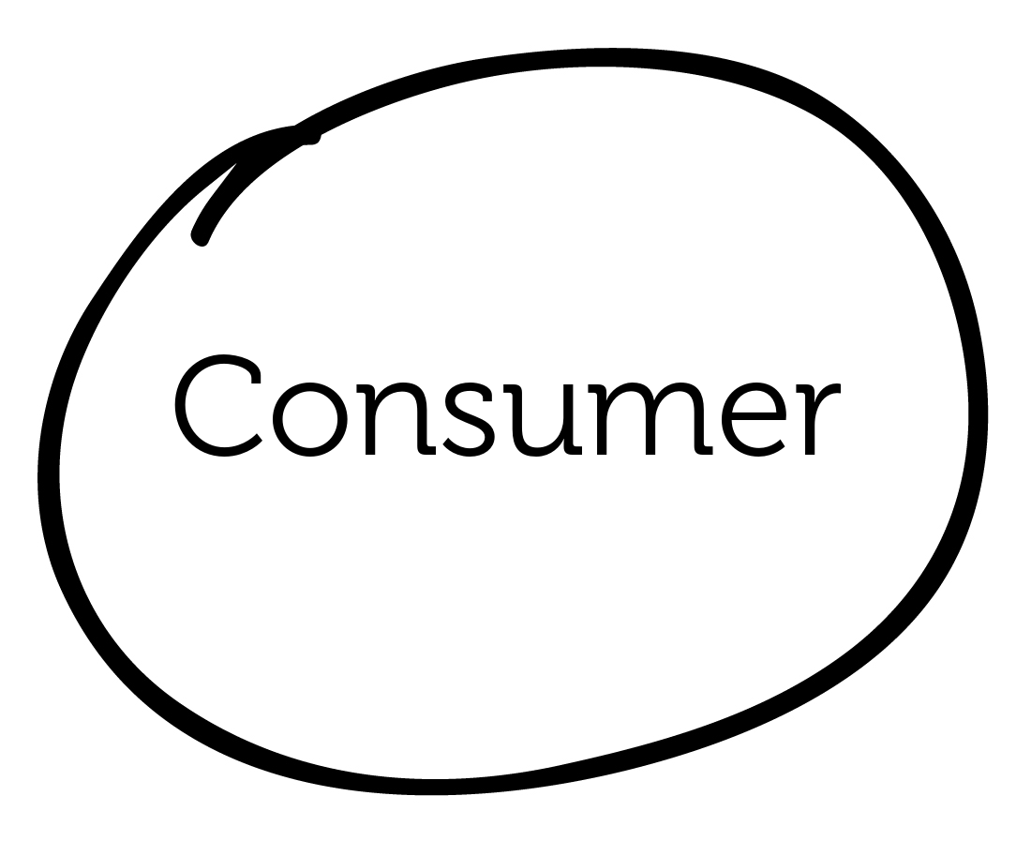
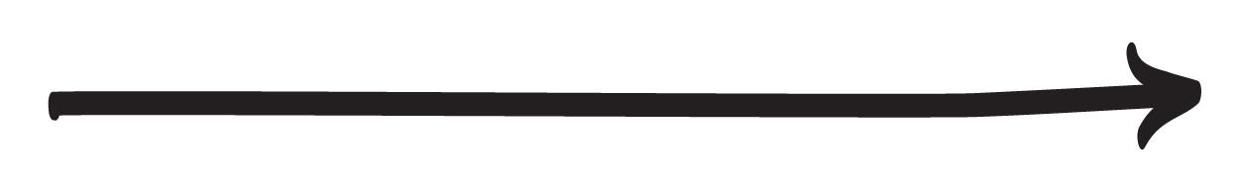
A BETTER WAY TO TEST MICROSERVICES

Slide 25

A BETTER WAY TO TEST MICROSERVICES
Specification first design
1
2

Slide 26
A BETTER WAY TO TEST MICROSERVICES
Specification first design
Solved problems
New problems
Good documentation
Aides discoverability and communication between teams/organisations
Clearer expectations on API
Who is using my API?
Requires diligence to ensure backwards compatibility
Developers hate maintaining versioning
Limited by expressiveness of specification (vague)
= Hard to get 100% coverage (can only say “not incompatible”)
Notes:
Speed
Isolation
Simplicity
But how can we do this across service boundaries???

Slide 27
A BETTER WAY TO TEST MICROSERVICES
Enter Consumer Driven Contracts

Slide 28
A BETTER WAY TO TEST MICROSERVICES

Slide 29
A BETTER WAY TO TEST MICROSERVICES
Consumer Driven Contracts
Benefits
You know when you break a consumer
You get a form of documentation
You can test things independently
Notes:
Speed
Isolation
Simplicity
But how can we do this across service boundaries???

Slide 30
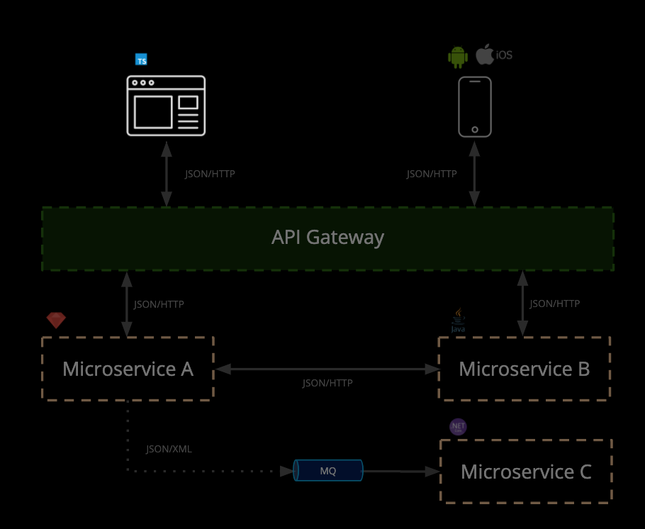
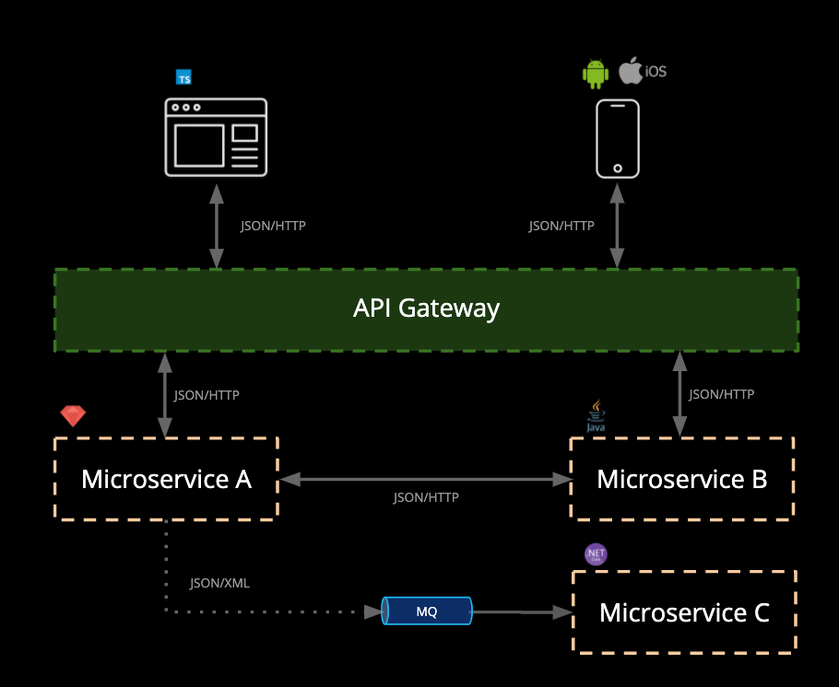
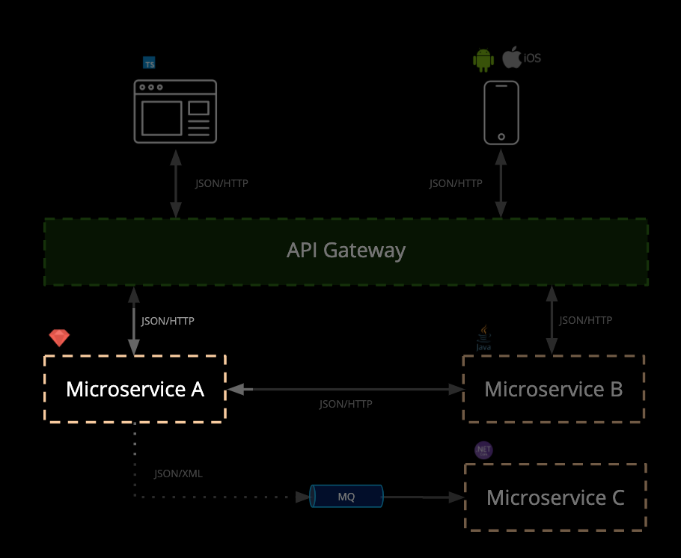
REDUCING THE COST > contract testing
What is Contract Testing?
An alternative approach
Benefits:
Simpler - test a single integration at a time - without having to deploy
No dedicated test environments - run on a dev machine
Get fast, reliable feedback
Tests that scale linearly
Deploy services independently
Pact removes the need for complicated release coordination: we have static knowledge about system compatibility.
Notes:
Contract testing was the cornerstone of this reinvestment strategy.
Contract tests allow us to check that the messages sent and received between system components are correct, by capturing the needs in a contract and making the interactions and scenarios explicit.
For example: can the website send the correct message to this API, and will this API send the appropriate response?
CLICK FORWARD ->
On this diagram (and most diagrams), anywhere there is an arrow between systems you have a contract. Contract tests aim to ensure those integration points are compatible and can evolve safely over time.
Traditionally this is covered in e2e tests.
Pact tests….

Slide 31
PRODUCT
What is Pact?
Microservice testing made easy
Pact is an Open Source, consumer driven contract testing tool that makes it easy to test microservices quickly, independently and release safely.
Use cases:
Javascript web applications (e.g. React)
Native mobile applications
RESTful microservices with JSON and XML
Asynchronous messaging (e.g. MQ)
Goals:
Removing end-to-end integrated tests
Reducing reliance on complex test environments
JSON/HTTP
JSON/HTTP
API Gateway
JSON/HTTP
JSON/HTTP
Microservice A
Microservice B
JSON/HTTP
JSON/XML
Microservice C
MQ

Slide 32




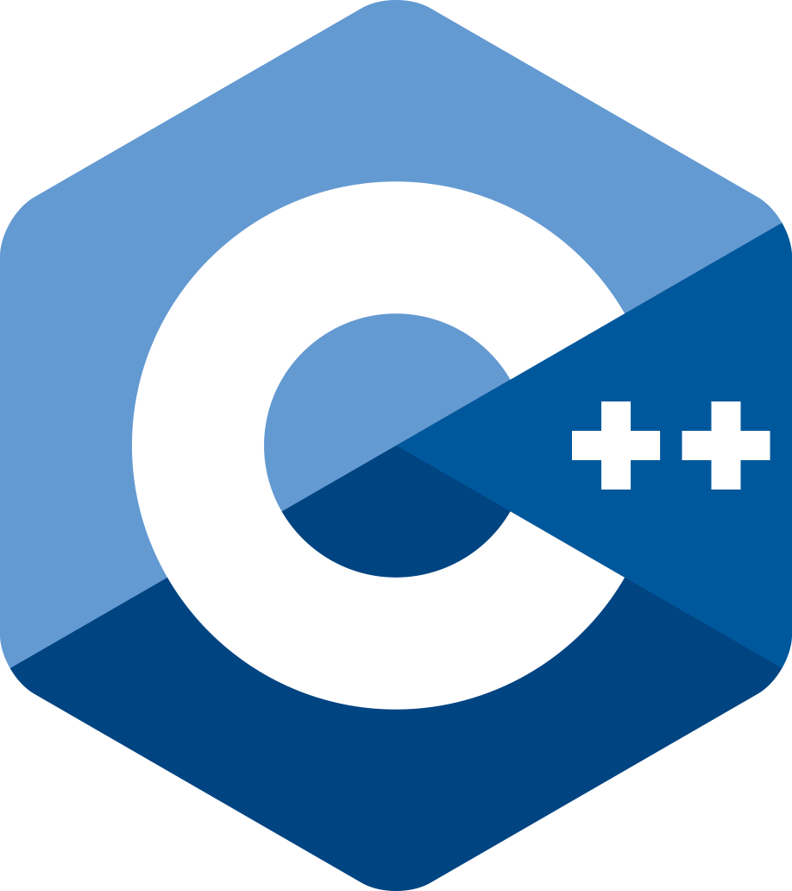



PRODUCT
Open Source
...and in your preferred language

Slide 33
Concepts
Interaction Types
Use Cases
Types of interactions:
Synchronous/HTTP
Asynchronous/Messages
Synchronous/Messages
By combining interaction types with the various Plugin capabilities, rich support for various frameworks and protocols emerge.
REST (JSON/HTTP), SOAP (XML/HTTP), JSON-RPC, GraphQL
Kafka, Fire and Forget, Server Push
gRPC/protobufs, Websockets, MQTT, Data Pipelines, AWS Lambda
https://github.com/pact-foundation/pact-specification/tree/version-4#interactions
Notes:
The Interaction Types is an abstraction that helps us model the various different types of integrations.
Synchronous/HTTP
This is the original Pact interaction (V1/V2), and represents a synchronous request/response, executed over HTTP. It contains a request entity with all the HTTP attributes required to construct an HTTP request, and an equivalent response entity.
Asynchronous/Messages
Asynchronous messages represent a one-way interaction between a provider and consumer i.e. fire and forget
Synchronous/Messages
Synchronous messages represent a request/response+ interaction between a provider and consumer. They represent non-HTTP interactions where a request message is sent to a provider, and one or more response messages are returned. Example interactions that would use this form are gRPC and Websockets.
By combining the various plugin types and Interaction types, most API integration approaches can be covered.
For instance, with gRPC you have:
Unary (request/response)
Client streaming – many requests, single response
Server streaming – single request, many responses
Server push. Would you just model this as Asynchronous/Messages like you would with a Kafka producer publishing to a queue? that is, the consumer would expect to receive a server push and then the

Slide 34
HOW PACT WORKS
(HTTP)
Notes:
Before we launch in to this - how does this resonate with you?

Slide 35
HOW IT WORKS > OVERVIEW
3
Contract is shared amongst teams to enable collaboration, using tools like Pactflow
Required interactions are captured into a contract between systems
2
4
Requests in contract replayed against provider API and verified against consumer(s) expectations
Contract
1
5
Consumer unit tests its behaviour against provider mock
Provider tests mock out any other systems, so it can be tested in isolation

Slide 36
HOW IT WORKS > HTTP > TERMINOLOGY
Consumer
Contract
GET /orders/1234
{
“id”: 1234,
“items”:[
...
],
}
Microservice B
Provider
Notes:
Let’s get our vocabulary clear

Slide 37

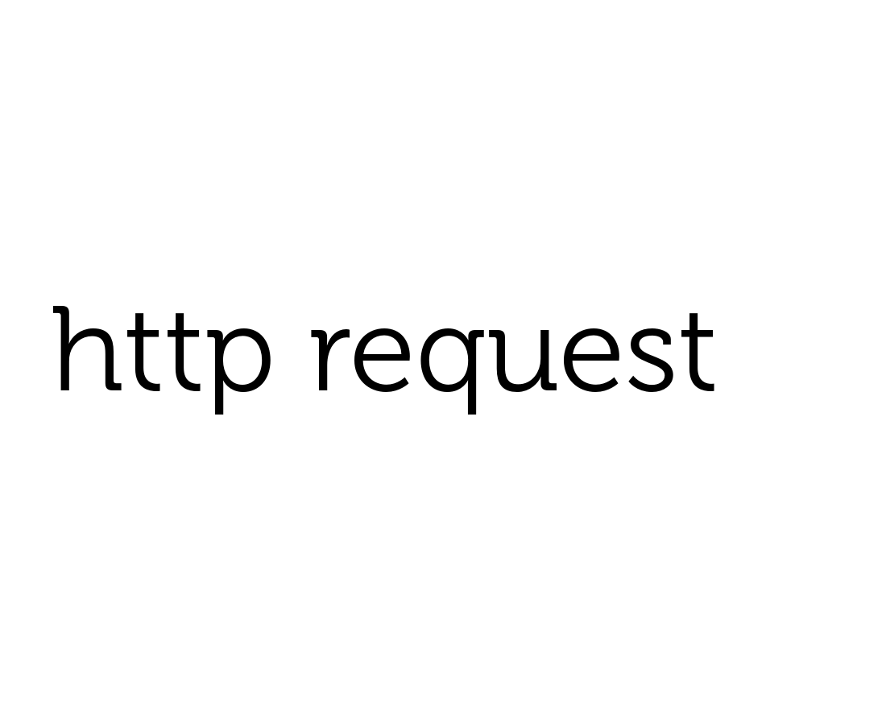
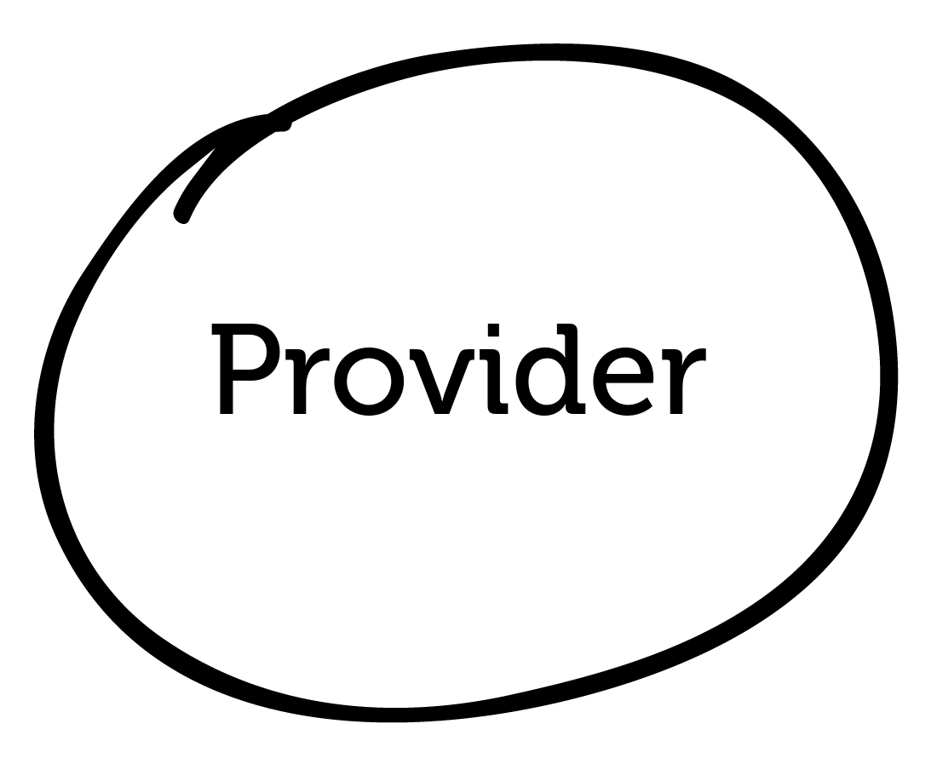
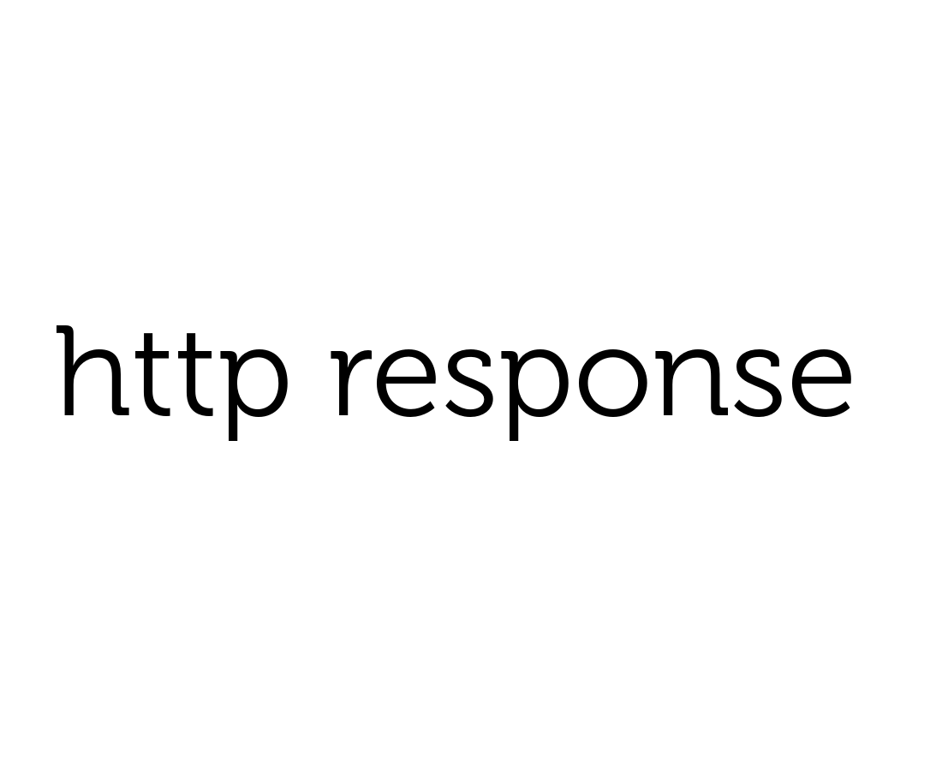
HOW IT WORKS > HTTP
Microservice B

Slide 38
HOW IT WORKS > HTTP
Step 1: test the consumer (contract capture)
Mock
Microservice B

Slide 39
HOW IT WORKS > HTTP
Step 1: test the consumer (contract capture)
Mock
GET /orders/1234
Microservice B

Slide 40
HOW IT WORKS > HTTP
Step 1: test the consumer (contract capture)
Mock
GET /orders/1234
{
“id”: 1234,
“items”:[
...
],
}
Microservice B

Slide 41
HOW IT WORKS > HTTP
Step 1: test the consumer (contract capture)
Mock
GET /orders/1234
✔︎
Pact mock checks:
Consumer makes the correct call to API
Consumer code can handle the response
{
“id”: 1234,
“items”:[
...
],
}
Microservice B

Slide 42



HOW IT WORKS > HTTP
Step 2: share the contract with the Pactflow
Mock
Microservice B

Slide 43
HOW IT WORKS > HTTP
Step 3: test the provider (contract validation)
Pact
GET /orders/1234
Microservice B

Slide 44
HOW IT WORKS > HTTP
Step 3: test the provider (contract validation)
Pact
GET /orders/1234
{
“id”: 1234,
“items”:[
...
],
}
Microservice B

Slide 45
HOW IT WORKS > HTTP
Step 3: test the provider (contract validation)
Pact
✔︎
Microservice B
Notes:
Results are shared back to the broker

Slide 46
HOW IT WORKS > HTTP
Step 3: test the provider (contract validation)
Pact
GET /orders/1234
✔︎
Pact verifier checks:
All known consumers of the provider
Provider can respond to all requests for each consumer
For each request, the response (headers, status, body etc.) matches rules in the contract
{
“id”: 1234,
“items”:[
...
],
}
Microservice B

Slide 47
Scope of consumer test
HOW IT WORKS: CONSUMER
Adapters
Services
Domain
External Service
Collaborators
Repositories

Slide 48
Scope of Provider Test
HOW IT WORKS: PROVIDER
Adapters
Services
Domain
mock
Collaborators
Repositories
In-memory database

Slide 49
HOW IT WORKS
(bi-directional contracts - PactFlow only feature)
Notes:
Before we launch in to this - how does this resonate with you?

Slide 50
PROBLEM STATEMENT
what are bi-directional contracts?
When contract-testing with Pact, you need to write and maintain a separate set of tests that are responsible for ensuring systems are compatible.
Unlike Pact, Bi-directional contracts allows teams to generate a contract from existing mocks (such as Wiremock), and to verify API providers using the functional API testing tools they are already using (such as Postman). Teams can use our plug-and-play adapters for popular tools or write their own.
All of the usual PactFlow collaboration tools and benefits apply, including the use of tools such as can-i-deploy.
With bi-directional contracts, you can “upgrade” your existing tools into a powerful contract-testing solution, simplifying adoption and rapidly improving time-to-value and ROI.

Slide 51



HOW IT WORKS > BI-DIRECTIONAL CONTRACTS
How it works
Mock
(e.g. Pact)
Publish contract
Provider Testing Tool (BYO)
4
Consumer tests behaviour against mock
1
Consumer
Provider
3
Publish to Pactflow
2
Produces a “consumer contract”
Verifies a “provider contract”
5
Notes:
New concepts terms
“Consumer contract”
“Provider contract”
“Evidence”
“Cross contract validation”

Slide 52
HOW IT WORKS > BI-DIRECTIONAL CONTRACTS
How it works
Mock
(e.g. Pact)
Publish contract
Provider Testing Tool (BYO)
3
Consumer tests behaviour against mock
1
6
Pactflow will perform a check, to confirm that the Pact contract is compatible with the Provider OAS
Consumer
Provider
This is called the
“cross contract validation”
2
Produces a “consumer contract”
Verifies a “provider contract”
4
Notes:
New concepts terms
“Consumer contract”
“Provider contract”
“Evidence”
“Cross contract validation”

Slide 53
HOW IT WORKS > BI-DIRECTIONAL CONTRACTS
How it works
Mock
Publish contract
Provider Testing Tool
3
5
1
Pactflow will perform a check, to confirm that the Pact contract is compatible with the Provider OAS
Consumer
Provider
Evidence
Evidence
This is called the
“cross contract validation”
2
Produces a “consumer contract”
Verifies a “provider contract”
4
Notes:
New concepts terms
“Consumer contract”
“Provider contract”
“Evidence”
“Cross contract validation”

Slide 54
PROBLEM STATEMENT
(why bi-directional contracts?)

Slide 55
PactFlow
(+ Pact Broker)

Slide 56
PROBLEM STATEMENT
why try a different approach?
Non-technical reasons:
Steep learning curve - Education often required to get the most of Pact
Technical investment required - Pact requires both parties of an integration point to write and maintain tests
Developer only - Pact requires access to the source code, excluding some roles from participating
Suitability for API first design workflows - many organisations have a provider-first workflow
Convincing people - there are a number of excuses!
Technical reasons:
Applicability to certain architectures / classes of problems - Pact is not ideally suited to working with API gateways, 3rd party APIs or APIs with large numbers of consumers.
UI testing - Creating pacts from UI tests can lead to pain if not done carefully

Slide 57
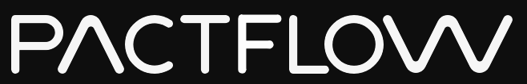

HOW PACT WORKS
(Async/Messages)
Brought to you by
Notes:
Before we launch in to this - how does this resonate with you?

Slide 58

HOW IT WORKS > ASYNC > TERMINOLOGY
Consumer
Product Catalog
Contract
topic: products
content-type: application/json
{
“id”: 1234,
“items”:[
...
],
}
Order Management
Provider (Producer)
Notes:
Let’s get our vocabulary clear

Slide 59
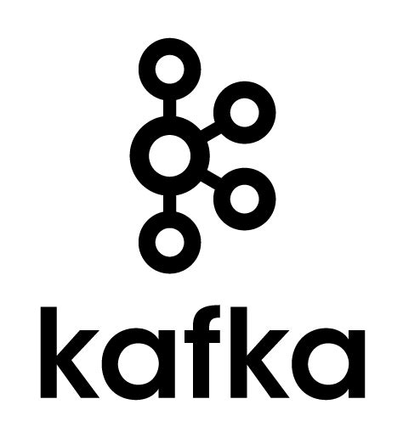
HOW IT WORKS > ASYNC
publish event
Product Catalog
Order Management

Slide 60
HOW IT WORKS > ASYNC
Step 1: test the consumer (expects to receive…)
Pact
Product Catalog
Order Management

Slide 61
HOW IT WORKS > ASYNC
Step 1: test the consumer (expects to receive…)
Pact
message
{
“id”: 1234,
“items”:[
...
],
}
Product Catalog
Order Management

Slide 62
HOW IT WORKS > ASYNC
Step 1: test the consumer (expects to receive…)
Pact
✔︎
Pact checks:
It can invoke the message handler
Handler can successfully process event
message
{
“id”: 1234,
“items”:[
...
],
}
Product Catalog
Order Management

Slide 63
HOW IT WORKS > ASYNC
Step 2: share the contract with the Pactflow
Pact
message
Product Catalog
Order Management

Slide 64
HOW IT WORKS > ASYNC
Step 3: test the provider
Pact
invoke function
message
Product Catalog
Order Management

Slide 65
HOW IT WORKS > ASYNC
Step 3: test the provider
Pact
✔︎
invoke function
message
produces event
{
“id”: 1234,
“items”:[
...
],
}
Product Catalog
Order Management

Slide 66
HOW IT WORKS > ASYNC
Step 3: test the provider
✔︎
Pact checks:
It can invoke the message producer fn
fn produces correct message
Pact
invoke function
message
produces event
{
“id”: 1234,
“items”:[
...
],
}
Product Catalog
Order Management

Slide 67
CHALLENGES WITH PACT
Pact
Sharing and collaborating on pacts between teams
Lifecycle management: managing contracts across code branches and environments
Orchestrating builds to know when it is safe to deploy
Integrating into your processes and tooling

Slide 68








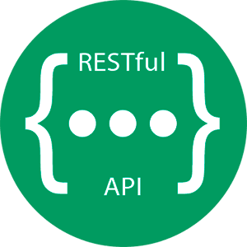

PRODUCT
PactFlow
Contract testing at scale
Additional Capabilities
Fully managed platform + hardened for scale
Better user experience
Secure access management
Collaboration and insights
Expansion to other integration technologies*
* 2020 Roadmap
Security, Identity + Access Management
Collaboration
Tools
Intelligence
Integrations
MQ
Protocols
Broker
Insights
Pact + OSS Tooling

Slide 69
PRODUCT
Integrated collaboration tool to and share and manage pacts* between teams.
API documentation that is guaranteed to be up-to date
Visualisations of the relationships between your services
Dashboards containing contract verification status
Pact tagging and versioning
Webhooks for integration and communication
View pact diffs
...and more!
All powered by a RESTful API

Slide 70
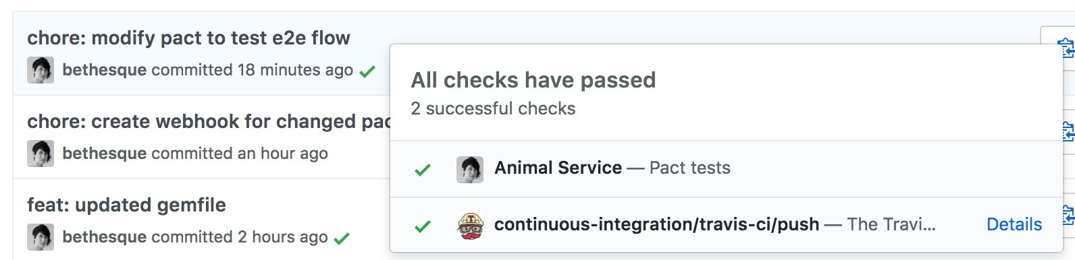
PRODUCT
Did I mention README badges and integrations?

Slide 71
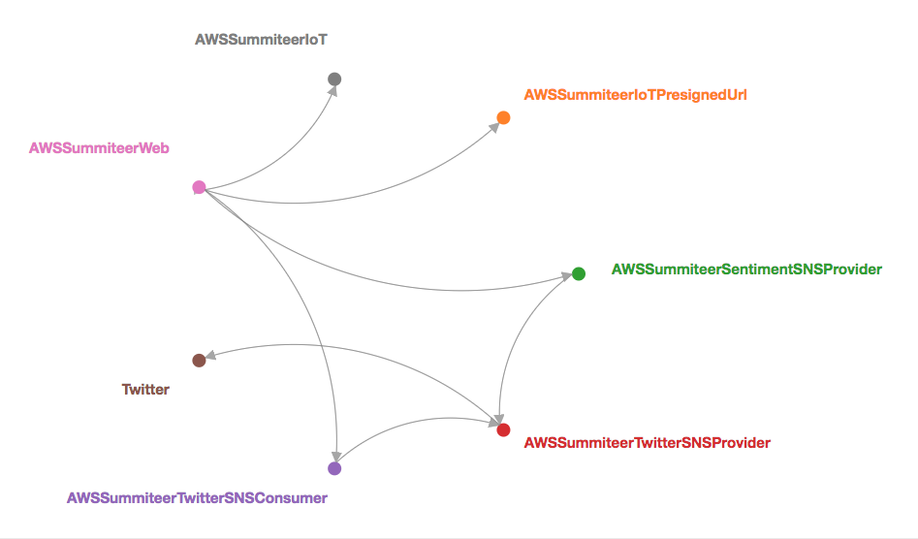
PRODUCT

Slide 72
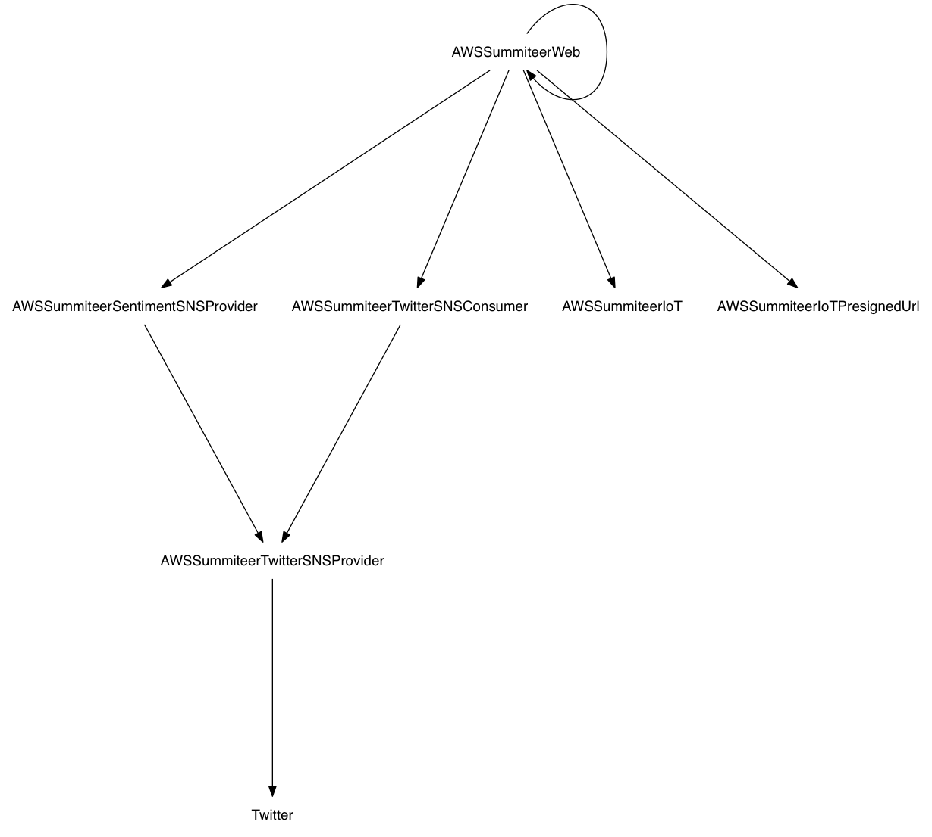
PRODUCT

Slide 73
PRODUCT
Verify that an application is safe to release
Enables “matrix” style testing
 | Consumer Head (1.0.1) | Consumer Prod (1.0.0)
Provider Head (2.0.0) | ? | ?
Provider Prod (1.1.13) | ? | Already tested

Slide 74
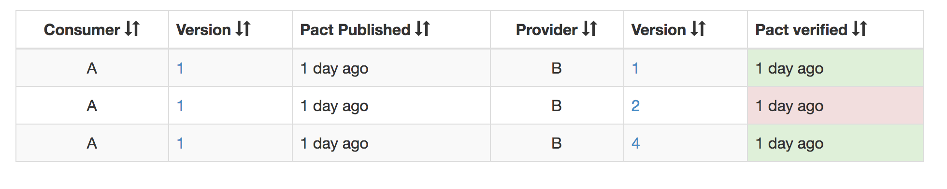
PRODUCT
$ pact-broker can-i-deploy
--app A --version 1
--app B --version 4

Slide 75
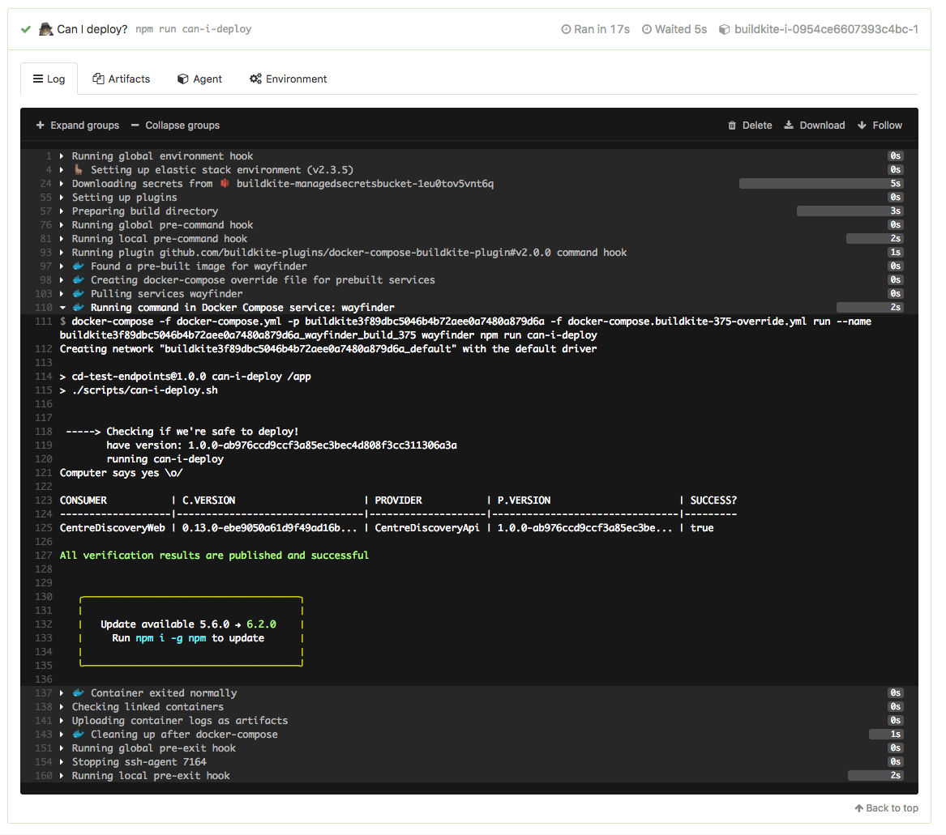
PRODUCT

Slide 76
PRODUCT

Slide 77




Team
Web: pactflow.io
Matt Fellows - Founder + JS/Go/Rust Maintainer @matthewfellows
Beth Skurrie - Founder + Ruby Maintainer/Pact Broker Creator
@bethesque
Ron Holshausen - Founder + Pact JVM/Rust Maintainer @uglyog

Slide 78
E2E
Integration
Unit Test
REDUCING THE COST
step 1: review test pyramid
Over investment here
Speed
Cost of feedback $
Confidence
Expensive
Cheaper
Number of tests
Notes:
A brief primer of the pyramid. It’s a heuristic to help you work out your allocation of time/effort on various types of testing, first proposed my Mike Cohn.
As you move up the pyramid, you get more confidence, but at the expense of slow and costly feedback.
Like the food pyramid, it says you should spend more time doing things at the bottom and less at the top.
We had over invested in e2e tests, and we were feeling the pain.

Slide 79
E2E
Integration
+ functional
Contract tests
Unit Test
REDUCING THE COST
step 2: rebalance test pyramid
Expensive
Cheaper
Speed
Cost of feedback $
Confidence
Increase functional and integration test coverage for business logic
Add contract tests to test integration points
Number of tests
Notes:
We gut the e2e tests, and spent some time adding a balance of functional tests.
We also added a whole new type of testing into the mix - contract tests.

Slide 80
E2E
Integration
+ functional
Contract tests
Unit Test
REDUCING THE COST
step 2: rebalance test pyramid
Expensive
Cheaper
Speed
Cost of feedback $
Confidence
Savings
Number of tests
Notes:
By pushing the line of expensive tests up the pyramid, we save on test execution time, maintenance costs and ultimately $$

Slide 81
E2E
Integration
+ functional
Contract tests
Unit Test
REDUCING THE COST
step 3: shrink the pyramid
Further savings
Expensive
Speed
Cost of feedback $
Confidence
Cheaper
$$$
Number of tests
Notes:
As alluded to earlier - we just didn’t need as many tests as we had.
A lot of the tests lost relevance over time, and with a critical eye it was more productive to delete them than to keep them around. Deleting code can be hard, but every test you keep is code that must be maintained, and in the long run that cost adds up.
We decided it would be better to put some of the testing effort “outside of the pyramid”

Slide 82
E2E
Integration
+ functional
Contract tests
Unit Test
REDUCING THE COST
step 4: continuous testing and monitoring
Canaries, smoke tests and automated rollbacks
Semantic monitoring / synthetic transactions
Improved telemetry and observability
Aggregated logging and access for the team
Tune monitoring & alerting
Investment here
Continuous testing
Post deployment
Before deployment
Expensive
Speed
Cost of feedback $
Confidence
Cheaper
Number of tests
Notes:
The test pyramid has a lot of weaknesses. A more holistic view is actually needed. Whilst this is outside the scope of this presentation, we recognised that the pyramid only helps us with the path to production.
An investment in our post deployment quality approach was required:
Production testing and monitoring was needed to ensure that we could indeed reduce MTTR and create engineering feedback loops to address root causes - something that can be more difficult when there is not a cross functional team and associated organisational alignment.
In our project, we eventually removed the E2E tests altogether in favour of these forms of testing.
Continuous testing doesn’t suffer from many of the issues of e2e tests. Because they run continually, and they may page you if they fail, they are less likely to be flakey. They don’t slow down a release and don’t require complex coordination amongst teams.

Slide 83
WORKSHOP
(https://github.com/pact-foundation/pact-workshop-js)
Notes:
Before we launch in to this - how does this resonate with you?

Slide 84
WORKSHOP
(https://github.com/pact-foundation/pact-workshop-js)
REMINDER
Pre-requisites
Node.js 16, 18 or 20
Clone project
Run npm i
Have a PactFlow account and a read-write API token
Comfortable operating a command line / terminal
OSX or Linux environment ideal

Slide 85
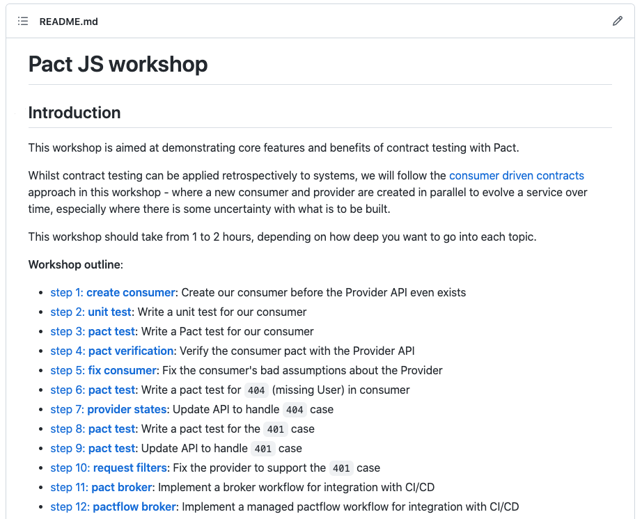
AGENDA + HOUSEKEEPING
Participating
Getting the most out of the workshop
Workshop arranged as a series of steps, each in a separate branch
We will progress each step as a group, but you are encouraged to explore as we go
Q&A will be available at the end of each step
Each step has specific learning objectives
✨ Follow the README!
Notes:
Any test where its success/failure depends on many different bits of interesting behaviour at once

Slide 86
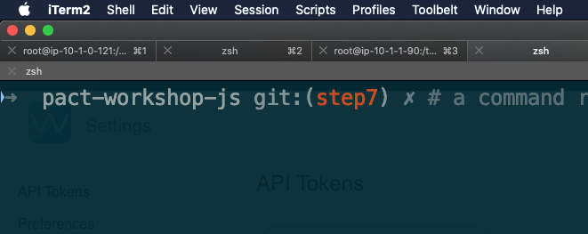
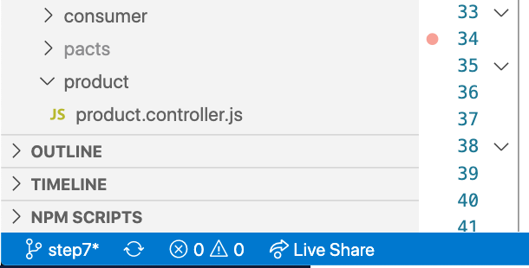
AGENDA + HOUSEKEEPING
Participating
Where am I?
Notes:
Any test where its success/failure depends on many different bits of interesting behaviour at once

Slide 87

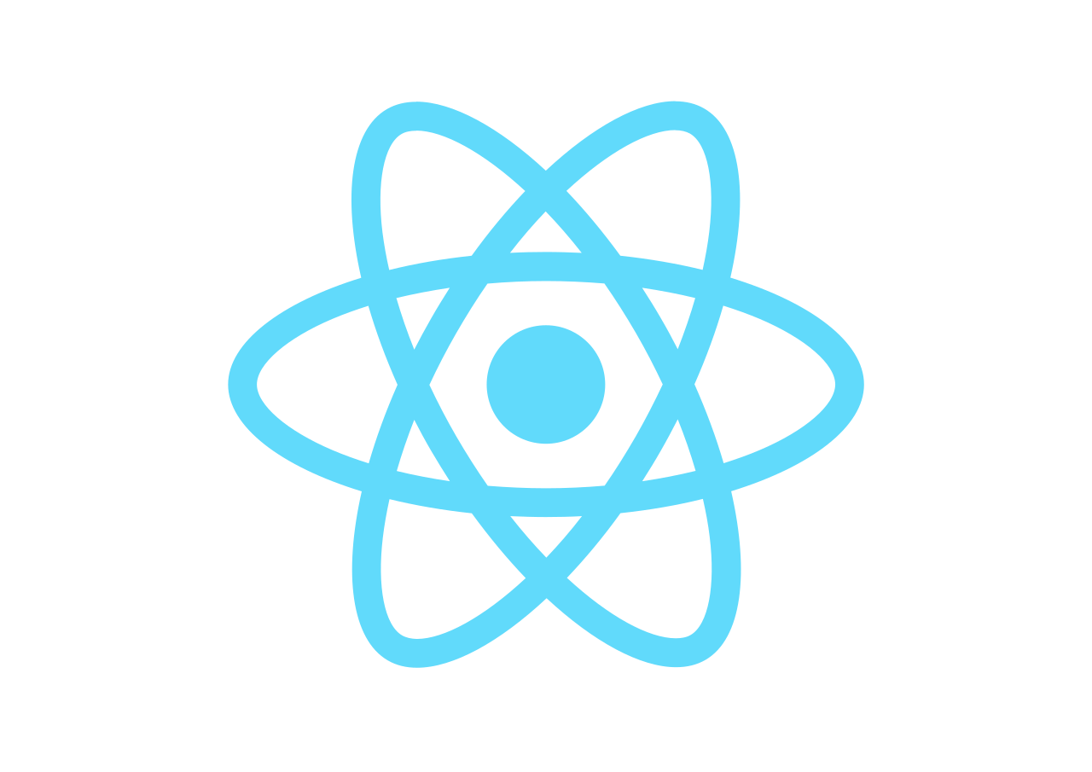
WORKSHOP: USE CASE
JSON/HTTP
Product API

Slide 88
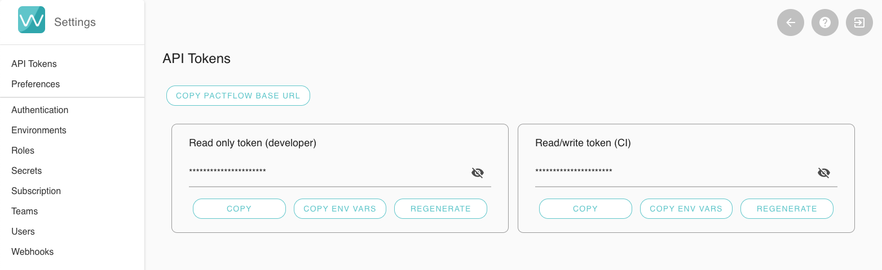
AGENDA + HOUSEKEEPING
Fetching your API Token (step 12)
Settings > API Tokens > read/write token
https://docs.pactflow.io/#configuring-your-api-token

